Slide 1

CSE211
Computer Organization and Design
Lecture : 3 Tutorial: 1 Practical: 0 Credit: 4
Deepak Kumar
(Asst. Professor, LPU)

Slide 2
Input/Output Organization <number> Lecture 36
Overview
Peripheral Devices
Input-Output Interface
Asynchronous Data Transfer
Modes of Transfer
Priority Interrupt
Direct Memory Access
Input-Output Processor

Slide 3
11-3 Asynchronous Data Transfer
  Synchronous Data Transfer
    All data transfers occur simultaneously during the occurrence of a clock pulse
    Two units such as CPU and I/O Interface are designed independently of each other. If the registers in the interface share a common clock with CPU registers. The transfer between the two are said to be synchronous.
  Asynchronous Data Transfer
    Internal timing in each unit (CPU and Interface) is independent
    Each unit uses its own private clock for internal registers
    Asynchronous data transfer between two independent units requires that control signals be transmitted between the communicating units to indicate the time at which data is being transmitted.
      STROBE
      HANDSHAKING

Slide 4
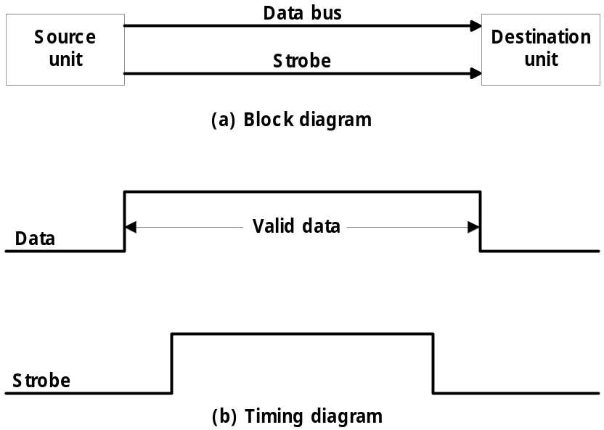
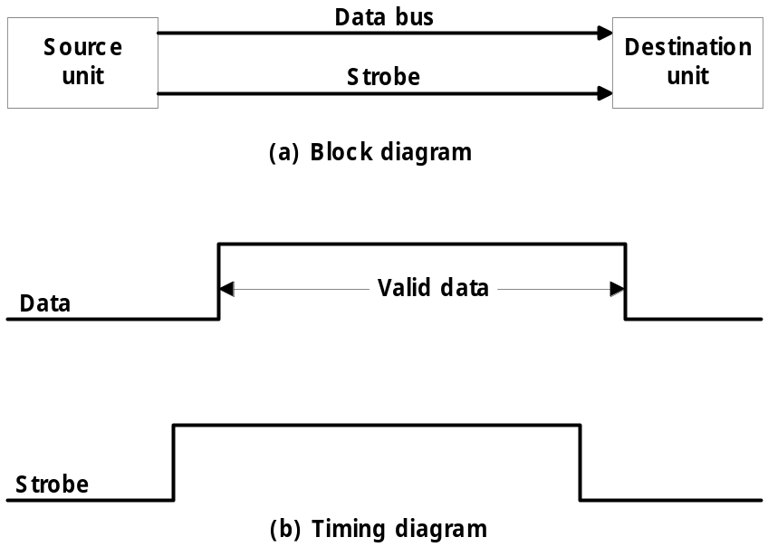
  Strobe : Control signal to indicate the time at which data is being transmitted
    1) Source-initiated strobe : Fig. 11-3
    2) Destination-initiated strobe : Fig. 11-4
    Disadvantage of strobe method
      Destination Data
      Handshake method Data
①
②
②
①
Fig. 11-3 Source-initiated strobe
Fig. 11-4 Destination-initiated strobe

Slide 5
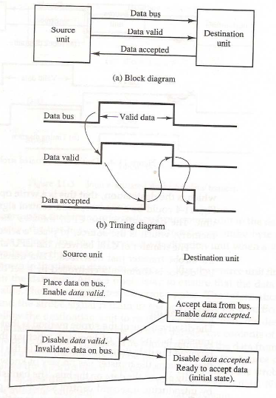
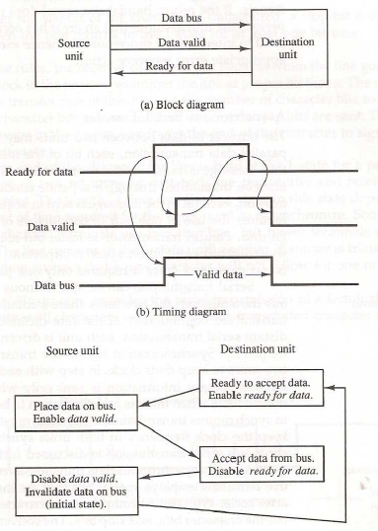
  Handshake : Agreement between two independent units
    1) Source-initiated handshake : Fig. 11-5
    2) Destination-initiated handshake : Fig. 11-6
    Timeout : If the return handshake signal does not respond within a given time period, the unit assumes that an error has occurred.
①
①
②
③
③
②
Fig. 11-5 Source-initiated handshake
Fig. 11-6 Destination-initiated handshake

Slide 6
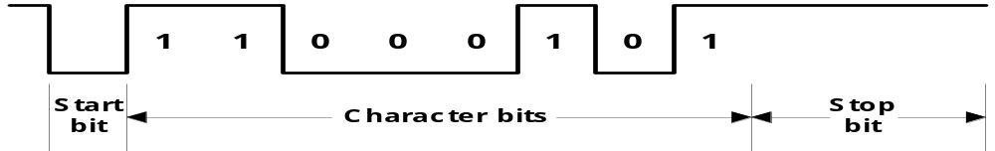
  Asynchronous Serial Transfer
    Synchronous transmission :
      The two unit share a common clock frequency
      Bits are transmitted continuously at the rate dictated by the clock pulses
    Asynchronous transmission :
      Binary information sent only when it is available and line remain idle otherwise
      Special bits are inserted at both ends of the character code
      Each character consists of three parts :
        1) start bit : always “0”, indicate the beginning of a character
        2) character bits : data
        3) stop bit : always “1”
    Asynchronous transmission rules :
      ① When a character is not being sent, the line is kept in the 1-state
      ② The initiation of a character transmission is detected from the start bit, which is always “0”
      ③ The character bits always follow the start bit
      ④ After the last bit of the character is transmitted, a stop bit is detected when the line returns to the 1-state for at least one bit time
①
②
③
④

Slide 7
    Baud Rate : Data transfer rate in bits per second
      10 character per second with 11 bit format = 110 bit per second
    UART (Universal Asynchronous Receiver Transmitter) : 8250
    UART (Universal Synchronous/Asynchronous Receiver Transmitter) : 8251

Slide 8
Input/Output Organization <number>
Universal Asynchronous Receiver Transmitter
A typical asynchronous communication interface available as an IC
Transmit
Bidirectional
Transmitter
Shift
data
data bus
Bus
register
register
buffers
Control
Transmitter
Transmitter
register
control
clock
Chip select
and clock
CS
Internal Bus
RS
Timing
Status
Receiver
Receiver
CS RS Oper. Register selected
register
control
clock
0 x x None
I/O read
RD
and
and clock
1 0 WR Transmitter register
Control
Receive
1 1 WR Control register
I/O write
WR
Receiver
Shift
data
1 0 RD Receiver register
register
register
1 1 RD Status register
Transmitter Register
- Accepts a data byte(from CPU) through the data bus
- Transferred to a shift register for serial transmission
Receiver
- Receives serial information into another shift register
- Complete data byte is sent to the receiver register
Status Register Bits
- Used for I/O flags and for recording errors
Control Register Bits
- Define baud rate, no. of bits in each character, whether to generate and check parity, and no. of stop bits

Slide 9



